Slide 1
Information for Prospective Volunteers
Reading IASS for SEND
February 2022

Slide 2
About Reading IASS for SEND
A statutory service offering information, advice and support to children, young people, parents and carers of children aged 0-25 with special educational needs or disability (SEND).
Helps people to express their views
Operates at arm’s length from Brighter Futures for Children
Provides support and advice that is free, impartial and confidential.

Slide 3
How we help
Education should be a partnership between parents and professionals, but sometimes the relationship can become less effective if
a parent or carer is unhappy with the SEND provision their child is receiving
or
does not understand the education system, legal framework or terminology surrounding SEND

Slide 4
How you might help
Reading IASS supports parents and carers in understanding and navigating the SEND system
Volunteers have an important role to play in delivering aspects of this support.
Volunteers may:
Support a parent in meetings
Help them express their views
Take time to talk to them

Slide 5
Recruitment
Anyone interested in becoming a volunteer will complete an application form and be interviewed by the Volunteer Coordinator.
Two references will be requested, and an enhanced DBS check will be made.
This Photo by Unknown Author is licensed under CC BY-NC-ND
This Photo by Unknown Author is licensed under CC BY-NC-ND

Slide 6
Training for the role
Reading IASS will provide free training to give volunteers the grounding, knowledge and skills needed to be effective.
Training will be flexible in terms of its delivery and will include:
The role of the volunteer
Information about the SEND Code of Practice
Effective Communication
Policies and procedures, including, for example, impartiality and confidentiality
Volunteer Supporters will also have the opportunity to undertake further online training in SEND law should they wish.

Slide 7
Support during training
There will be opportunities throughout the training period for the coordinator and the volunteer to consider whether volunteering with Reading IASS for SEND is an appropriate role for the trainee.
The Volunteer Coordinator will provide personal support and advice for volunteers, and if appropriate, individual tutorial sessions will be available.
If appropriate, after training, the volunteer will have an opportunity to shadow a member of Reading IASS staff, or an experienced volunteer.

Slide 8
Time commitment
Reading IASS responds to the needs of parents/carers as they arise.
Volunteers will be asked to take on support work on an ad hoc basis.
Typically, we would ask for a time commitment of a few hours a month, but this would vary according to individuals.

Slide 9
Support and supervision
The Volunteer Coordinator will offer ongoing support and supervision to volunteers.
Regular check-ins will be offered to all volunteers where there will be opportunity to discuss any problems or issues that may arise.
This Photo by Unknown Author is licensed under CC BY-NC

Slide 10
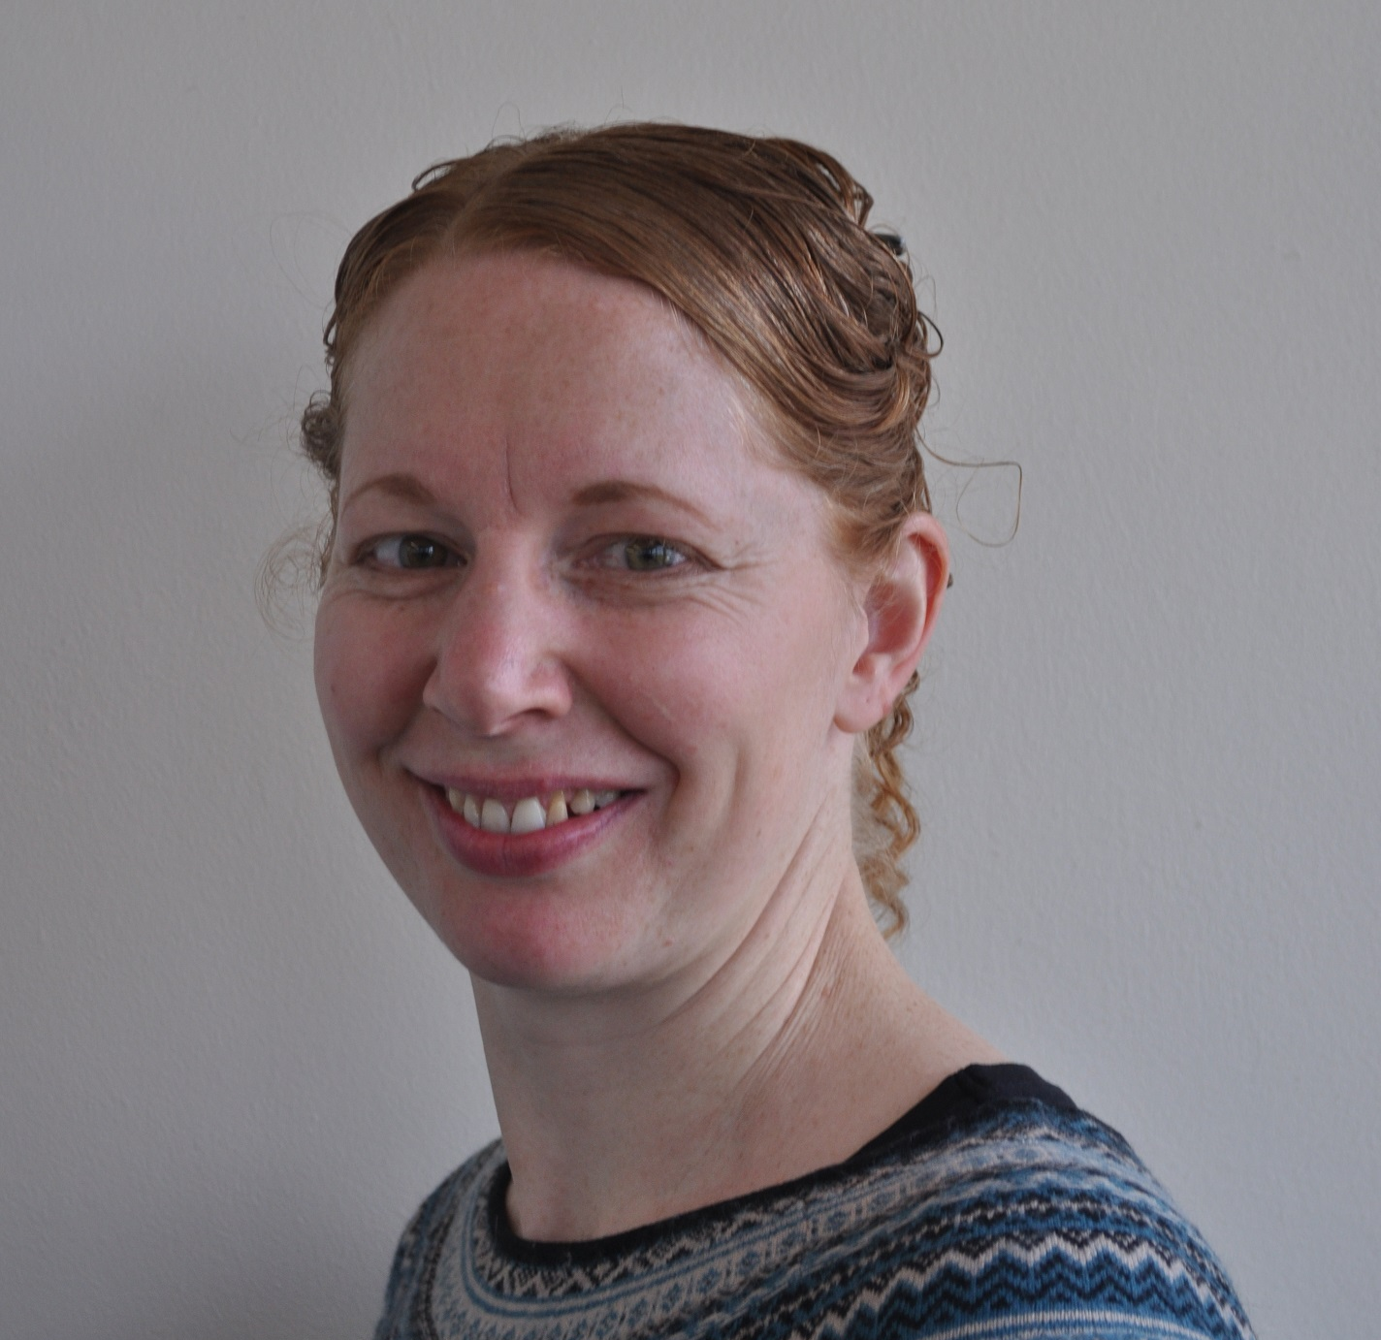
Contact
For an informal chat, please contact:
Call: 0118 937 3421 – ask for Sarah Bamford
Email: iass@brighterfuturesforchildren.org
This Photo by Unknown Author is licensed under CC BY-NC

